Slide 1
Money-Transaction-Income Process
(Quatification of Quantity Theory of Money)
BIJAN BIDABAD
BIJAN BIDABAD
WSEAS Post Doctorate Researcher
No. 2, 12th St., Mahestan Ave., Shahrak Gharb, Tehran, 14658 IRAN
bijan@bidabad.com http://www.bidabad.com
Notes:
To view this presentation, first, turn up your volume and second, launch the self-running slide show.

Slide 2
ABSTRACT
In this paper we try to establish the relationship between money and income via transaction. In this regard, we use different processes of value added production in economy to find this lost chain in literature. According to our findings, we reformulate and generalize the quantity theory of money. Our empirical investigations confirm our model formulations.
Notes:
To view this presentation, first, turn up your volume and second, launch the self-running slide show.

Slide 3
Introduction
Fisher’s quantity theory of money establishes an exact relationship between money and transactions. But, other economists tried to link money to income via quantity theory of money by assuming that real income is a suitable scale variable for total volume of transactions. This assumption simply relates money to income without reliable economic evidences.
Notes:
For more than 20 years, Duarte has developed presentations…

Slide 4
Consider the following two equations. Equation (1) is the original Fisher’s quantity theory and equation (2) is the other's interpretation of quantity theory.
MV = Pt = T (1)
MV = Py = Y (2)
where,
M: Stock of money.
V: Velocity or circulation of money.
P: Price level.
y: Real Income.
Y: Nominal income.
t: Volume of transaction.
T: Value of transaction.
D
In the equation (1), Fisher discusses around the quantity and value of goods and services sold, but by equation (2), other economists interpret that income is a suitable scale variable for transaction, and they link MV to income (produced value added) in the economy by simply replacing “y” by “t”. In this section, now, we are going to determine the exact relationship between these two fundamental variables. On the other hand, it is tried to bridge between Fisher’s original quantity theory (MV=Pt) and revisionists’ interpretation of quantity theory (MV = Py) in a logical frame.
Notes:
…to launch products,

Slide 5
Value of Transactions in Production Process
To find out the relationship of value added (income) to the amount of nominal payment required to perform corresponding transactions; we try to follow the procedure that value added is produced in the economy.
Notes:
…align employees,

Slide 6
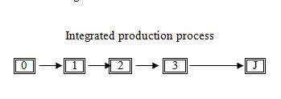
J | C_{j} | Y_{j} | Y | P_{j} | T_{j} | T
0 1 2 3 . . . J | C₀ C₁ C₂ C₃ . . . C_{J} | 0 Y₁ Y₂ Y₃ . . . Y_{J} | 0 Y₁ Y₁+ Y₂ Y₁+ Y₂ + Y₃ . . . . . . . . . . . . . . . Y₁ + … + Y_{J} | P₀ P₀ + Y₁ P₀ +Y1+ Y₂ P₀ +Y1+ Y₂ + Y₃ . . . . . . . . . . . . . . . . . . P₀ +Y1 + … + Y_{J} | 0 P₀ + Y₁ P₀ +Y1+ Y₂ P₀ +Y1+ Y₂ + Y₃ . . . . . . . . . . . . . . . . . . P₀ +Y1 + … + Y_{J} | 0 T₁ T₁ + T₂ T₁ + T₂ + T₃ . . . . . . . . . . . . . . . T₁ + … + T_{J}
D
Integrated production process
Notes:
…to launch products,

Slide 7
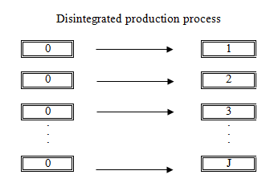
j | C_{j} | Y_{j} | Y | P_{j} | T_{j} | T
0 1 2 3 . . . J | C₀ C₁ C₂ C₃ . . . C_{J} | 0 Y₁ Y₂ Y₃ . . . Y_{J} | 0 Y₁ Y₁+ Y₂ Y₁+ Y₂ + Y₃ . . . . . . . . . Y₁ + … + Y_{J} | P₀ P₀ + Y₁ P₀ +Y₂ P₀ + Y₃ . . . . . . P₀ + Y_{J} | 0 P₀ + Y₁ P₀ + Y₂ P₀ + Y₃ . . . . . . P₀ + Y_{J} | 0 T₁ T₁ + T₂ T₁ + T₂ + T₃ . . . . . . . . . T₁ + … + T_{J}
Notes:
…increase company value,

Slide 8
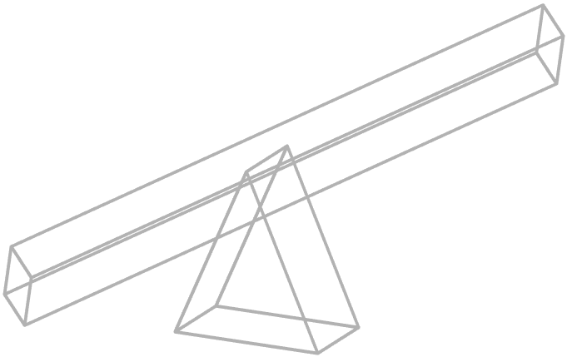
Mixed production process
Notes:
…and propel

Slide 9
Total Transactions and Foreign Trade
Notes:
…global causes.

Slide 10
5
Quantity Theory of Money, Reformulated
MV = (P₀ + 1- α) PA + ½ α (PA)² + PB = T = Pt
0≤α≤1, P₀≥0
Notes:
Along the way we’ve discovered…

Slide 11
Empirical Analyses
T_{t} = ß₁Y_{t} + ß₂Y²_{t} + u_{t}
Where;
T_{t}: Total value of transactions at time t.
Y_{t}: Nominal income at time t.
u_{t}: Disturbance term.
ß_{1,} ß_{2:} Regression coefficients.
Notes:
Presentations are a powerful communication medium.

Slide 12
Empirical Analyses
T_{t} = ß₁Y_{t} + ß₂Y²_{t} + u_{t}
Where;
T_{t}: Total value of transactions at time t.
Y_{t}: Nominal income at time t.
u_{t}: Disturbance term.
ß_{1,} ß_{2:} Regression coefficients.
Notes:
Presentations are a powerful communication medium.

Slide 13
To calculate total debits, we combined debits on demand deposits as a proxy for total deposit transactions and three different types of debits on currency as proxies of total currency transactions.
In this regard, three alternative scenarios adopted to approximate total debits, namely, T⁽¹⁾, T⁽²⁾ and T⁽³⁾ with following definitions;
T⁽¹⁾ = Debits on demand deposits in all commercial banks.
T⁽²⁾ = Debits on demand deposits in all commercial banks +15 x (stock of currency).
T⁽³⁾ = Debits on demand deposits in all commercial banks + The dollar value of the amount of currency “received and counted” by Federal Reserve System.
Notes:
The first rule is: Treat your audience as king.

Slide 14
No. | Dep. Var. | ß₀ (^{S}ß₀ˆ) | ß₁ (^{S}ß₁ˆ) | ß₂ (^{S}ß₂ˆ) | Rho (^{S}_{rho}) | R² | Duration Watson
1 | T_{t}⁽¹⁾ | ----------- ----------- | 2.3236 (0.6327) | 0.0080 (0.0003) | 0.3572 (0.2228) | 0.9971 | 1.3708
2 | T_{t}⁽²⁾ | ----------- ----------- | 3.1624 (0.6357) | 0.0079 (0.0003) | 0.3514 (0.2258) | 0.9972 | 1.3769
3 | T_{t}⁽³⁾ | ----------- ----------- | 2.3793 (0.6328) | 0.0080 (0.0003) | 0.3562 (0.2233) | 0.9971 | 1.3710
4 | T_{t}⁽¹⁾ | *-80.416* (1069.66) | 2.4620 (1.9902) | 0.0080 (0.0007) | 0.3509 (0.2505) | 0.9971 | 1.3747
5 | T_{t}⁽²⁾ | *+85.912* (1080.53) | 3.0158 (2.0054) | 0.0080 (0.0007) | 0.3568 (0.2467) | 0.9972 | 1.3736
4 | T_{t}⁽³⁾ | *-61.996* (1071.71) | 2.4855 (1.9939) | 0.0080 (0.0007) | 0.3515 (0.2504) | 0.9971 | 1.3739
Notes:
…five simple rules for creating world-changing presentations.

Slide 15
The first three rows are corresponded to equations (45) and completely confirm our hypothesis and model specification with special attention on the conditions stated before.
The rows of four through six of the table are corresponded to the specified model.
These rows also confirm our hypothesis that the estimated intercept should be insignificant.
All other calculated statistics confirm our hypothesis strongly.
Notes:
The first rule is: Treat your audience as king.

Slide 16
Money-Transaction-Income Process
(Quatification of Quantity Theory of Money)
BIJAN BIDABAD
NIKOS MASTORAKIS
BIJAN BIDABAD
WSEAS Post Doctorate Researcher
No. 2, 12th St., Mahestan Ave., Shahrak Gharb, Tehran, 14658 IRAN
bijan@bidabad.com http://www.bidabad.com
Notes:
To view this presentation, first, turn up your volume and second, launch the self-running slide show.

