Slide 1
Assets &Liabilities Management in Islamic Banking
the 3rd International Conference on Islamic Banking and Finance: Risk Management, Regulation and Supervision in Jakarta, Indonesia on 23-24 February, 2010
Bijan Bidabad
Mahmoud Allahyarifard
http://www.bidabad.com/
M_Allahyarifard@BMI.IR
Bijan@bidabad.com
Allahyarifard@Gmail.IR

Slide 2
Agenda
Compatibility and incompatibility of economic theories with Islamic banking
Criteria to distinguish usuric from non-usuric transactions
Assets and liabilities structure in Islamic banking
Assets and Liabilities Management (ALM) and risk indices
Mathematical Model for Comparative Economic Value Added (EVA) Analysis in both Banking
Comparision of Islamic and Conventional Banking
Conclusion
Q & A.

Slide 3
Compatibility and incompatibility of economic theories with Islamic banking
Probably, one of the usury illegalness reasons in Islamic banking may comes from affection of money market fluctuation on real economic sector that causes economic divergence from long run stability growth and imbalances in money market and other markets as well.

Slide 4
Criteria to distinguish usuric from non-usuric transactions
Loaner must share in profit/loss of the economic activity of loanee.
The rate of interest must not be determined and conditioned before.
Interest in consumption loans is usury.
Foreign currency exchange (without interest) is not usury

Slide 5
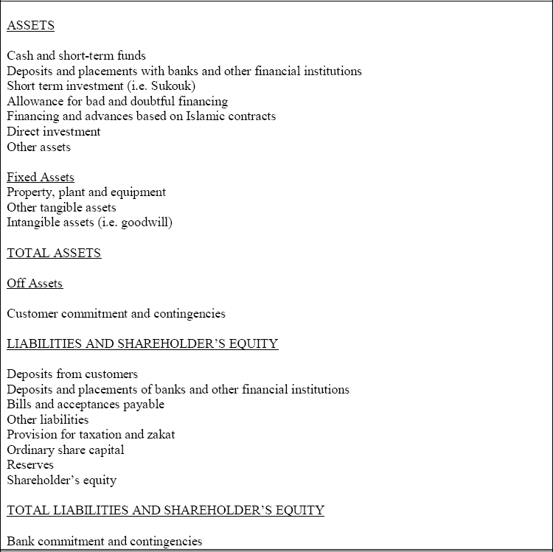
Balance sheet Structure of Islamic Bank

Slide 6
Cash asset & Liquidity Risk Indices
(1)

Slide 7
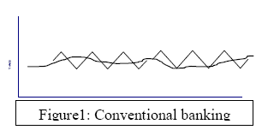
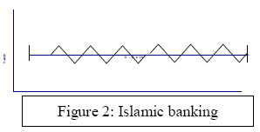
Comparative Rate of Return Fluctuations In both Banking Types
Rate
Time
Rate
Time

Slide 8
Tradeoff of the cost of maintaining liquidity against cost of insufficient liquidity

Slide 9
Asset side Core Items
High liquid Assets: Sukuk, Mousharekah Certificates (PLS), Mousharekah Bound(Oragh-e-moshrehkah)
Accounts and Notes receivable: Repurchase of debts (Kharid-e-Dayn) contraction.
Financing and advances based on Islamic contracts: Mudarabah & Moshrekah Finacing, Gharzolhasaneh

Slide 10
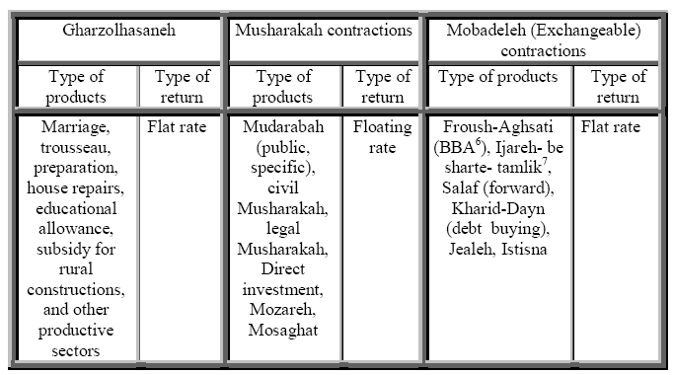
Asset side Core Items In Iran

Slide 11
Credit Risk Characteristics In Islamic banking
Total outstanding claims, allowance for bad and doubtful financing of government and non-government claims, debts of paid L/C on the base of Islamic contracts, irrecoverable receivable notes and others are classified in this group.
Non- performing Financing Characteristics In Islamic Banking:
Decline allowances for bad and doubtful financing because of transferring of a fraction of risk to depositors
More transparency on the balance sheet items
In case of bankruptcy and investment loss, amounts of investment is directly booked in costs accounts

Slide 12
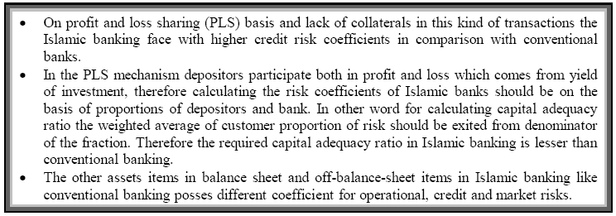
Capital Adequacy In Islamic Banking
(2)

Slide 13
Comparative Economic value added (EVA) in Both Banking Types
(3)
(4)
(5)
(6)
(7)

Slide 14
Comparative Economic value added (EVA) in Both types of Banks
(8)
(9)
(10)
(11)
(12)
So:
(13)

Slide 15
Results
Since provident reserve in PLS banking is lesser than conventional banking so financial efficiency in PLS banking is more than conventional banking. The main reason of more efficiency is due to stability in cash flows of PLS banking; so for covering liquidity risk less provident funds are required in comparison with conventional banking.
Lack of outstanding claims and doubtful claims in PLS banking because of nature of Musharakah contracts and supervision on investments decline coefficient in Islamic banking in comparison to conventional banking. Hence lack of this kind of inefficient assets will improve financial circulations in PLS banking than conventional banking and this will grow up the EVA in this kind of banking system.
Rate of return in PLS banking is more than the conventional banking, so consequently EVA in PLS banking is higher than conventional banking.

Slide 16
Comparative Liquidity Position
Indices | RHB Islamic banking |  | RHB Investment banking
 | 31.03.2007 RM,000 | 31.12.2006 RM,000 | 31.03.2007 RM,000 | 31.12.2006 RM,000
Cash balances with banks and other financial institutions | 35035 | 21283 | 35177 | 34147
Total assets | 8239971 | 8092265 | 72675509 | 6834756
 | 43% | 26% | 48% | 50%

Slide 17
Comparison of allowances for bad and doubtful financing in PLS banking and conventional banking (coefficient)
Indices | RHB Islamic banking |  |  |  | RHB Investment banking
 | 31.03.2007 RM,000 |  | 31.12.2006 RM,000 |  | 31.03.2007 RM,000 |  | 31.12.2006 RM,000
 | Amount | % | Amount | % | Amount | % | Amount | %
Public | 78479 | 1.78 | 77059 | 1.8 | 13128 | 1.59 | 10432 | 1.38
Specific | 49374 | 1.12 | 48822 | 1.14 | 63724 | 7.74 | 96458 | 12.72
Total | 127853 | 2.89 | 125881 | 2.95 | 76852 | 9.34 | 106890 | 14.1
Gross financing and advances or loans and advances, RM,000 | 4416945 |  | 4273454 |  | 823234 |  | 758173

Slide 18
Comparative financial indices in PLS and conventional banking
Indices | RHB Islamic banking |  | RHB Investment banking
 | 31.03.2007 % | 31.12.2006 % | 31.03.2007 % | 31.12.2006 %
ROA | .27 | 1.07 | .159 | .96
ROE | 3.28 | 13.25 | 1.64 | 9.24
Core capital ratio (including of market risk) | 17.36 | 17.78 | 18.5 | 20.29
Risk-weighted capital ratio (including market risk) | 15.44 | 15.84 | 14.6 | 16.02

Slide 19
Thank YOU
Bijan Bidabad
Mahmoud Allahyarifard
http://www.bidabad.com/
M_Allahyarifard@BMI.IR
Bijan@bidabad.com

